Slide 1
FACIAL
EMOTION DETECTION

Slide 2
Course Name : Mini Project Course Code : CSD317
Team Introduction
NAME | PRN
Kishor Shashikant Hange | 19UCS042
Vishal Dineshkumar Joshi | 19UCS050
Priyanshu Prakash Ekal | 19UCS033
Shubhamkar Suhas Kale | 19UCS052
Guided By Prof: S. J. Murchite.

Slide 3
Contents
Problem Description
Problem Statement
Problem Solution
Snapshots
Conclusion

Slide 4
Problem Description
Sentiment Analysis is already widely used by different companies to gauge consumer mood towards their product or brand in the digital world.
However, in offline world users are also interacting with the brands and products in retail stores, showrooms, etc. and solutions to measure user’s reaction automatically under such settings has remained a challenging task.
Emotion Detection from facial expressions using AI can be a viable alternative to automatically measure consumer’s engagement with their content and brands.

Slide 5
Problem Description
A candidate-interviewer interaction is susceptible to many categories of judgment and subjectivity. Such subjectivity makes it hard to determine whether candidate’s personality is a good fit for the job.
Identifying what a candidate is trying to say is out of our hands because of the multiple layers of language interpretation, cognitive biases, and context that lie in between.
That’s where AI comes in, which can measure candidate’s facial expressions to capture their moods and further assess their personality traits.

Slide 6
Problem Description
Video games are designed keeping in mind a specific target audience. Each video game aims to evoke a particular behavior and set of emotions from the users.
During the testing phase, users are asked to play the game for a given period and their feedback is incorporated to make the final product.
Using facial emotion detection can aid in understanding which emotions a user is going through in real-time as he is playing without analyzing the complete video manually.

Slide 7
Problem Description
Video games are designed keeping in mind a specific target audience. Each video game aims to evoke a particular behavior and set of emotions from the users.
During the testing phase, users are asked to play the game for a given period and their feedback is incorporated to make the final product.
Using facial emotion detection can aid in understanding which emotions a user is going through in real-time as he is playing without analyzing the complete video manually.
Emotion detection software enhance the overall user experience

Slide 8
Problem Statement
Develop the solution for detection of facial emotions using webcam.

Slide 9
Input/Output
Input
Video Frames
Output
Video frames indicating detected facial emotion.

Slide 10
Problem Solution
To develop the solution we used the TensorFlow, Keras, OpenCV and NumPy etc. OpenCV library used for capturing and processing of video frames. TensorFlow and Keras library used to train the deep learning model. NumPy library is used to convert images into NumPy matrix.
This solution recognizes facial emotion of “Happy”, “Angry”, “Sad”, “Surprised”, “Disgusted”, “Neutral”, “Fear”.

Slide 11
Problem Solution
Import required libraries.
Generate images of classes which have less images to avoid biasing.
Resize the images in the dataset.
Create training data array of images.
Shuffle the images randomly.
Separate Dependent variable(Output Label) and Independent variable(Image Matrix).
Normalize the matrix values.
Import a pretrained model.
Change the last layer classes to seven and create a new model.
Compile the new model.
Train the model on given training data.
Save the trained model.

Slide 12
Problem Solution
Import required libraries.
Create a dictionary of emotions and their numbers.
Load the model
Load the weights of the model.
Initialize the webcam using OpenCV.
Take video frames until ‘q’ key is not pressed.
Give the frame to face detection pretrained model.
Detect faces available on camera.
Take each face available on the camera and Preprocess it as follows:
Convert the coloured image to grayscale image.
Get the co-ordinates of faces to plot the rectangle.

Slide 13
Problem Solution
Get the cropped image of faces.
Predict the Emotion and find the corresponding dictionary value.
Output the emotion using OpenCV.

Slide 14
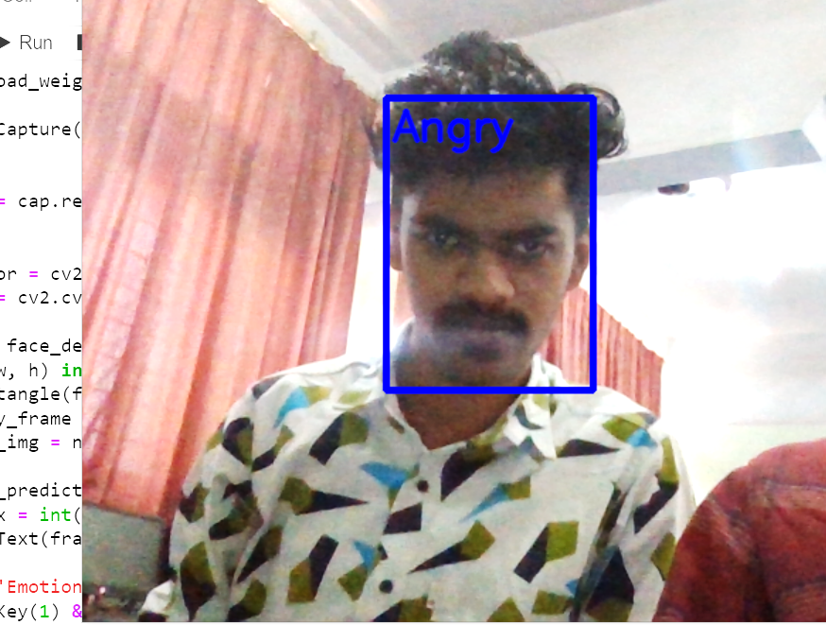
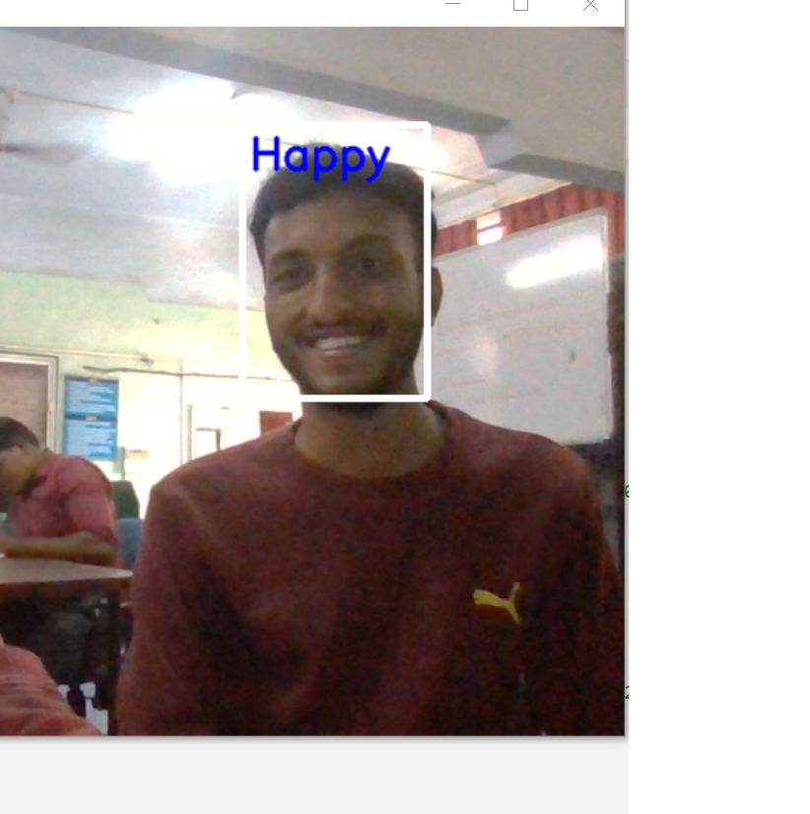
Snapshots

Slide 15
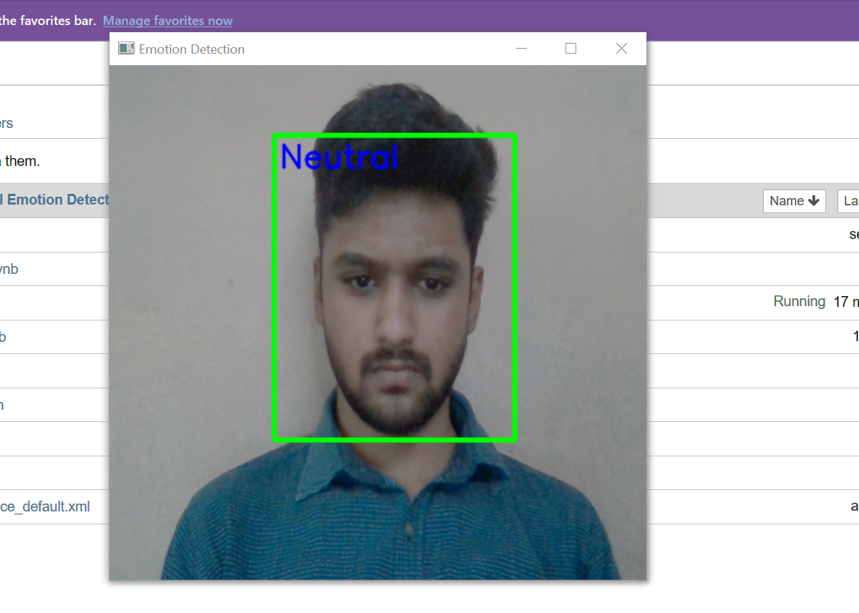
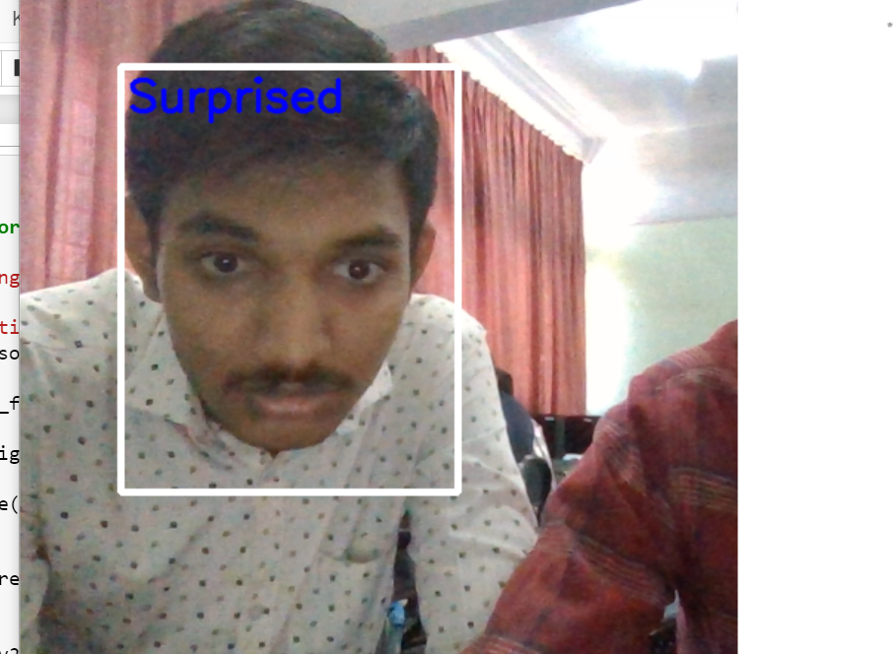
Snapshots

Slide 16
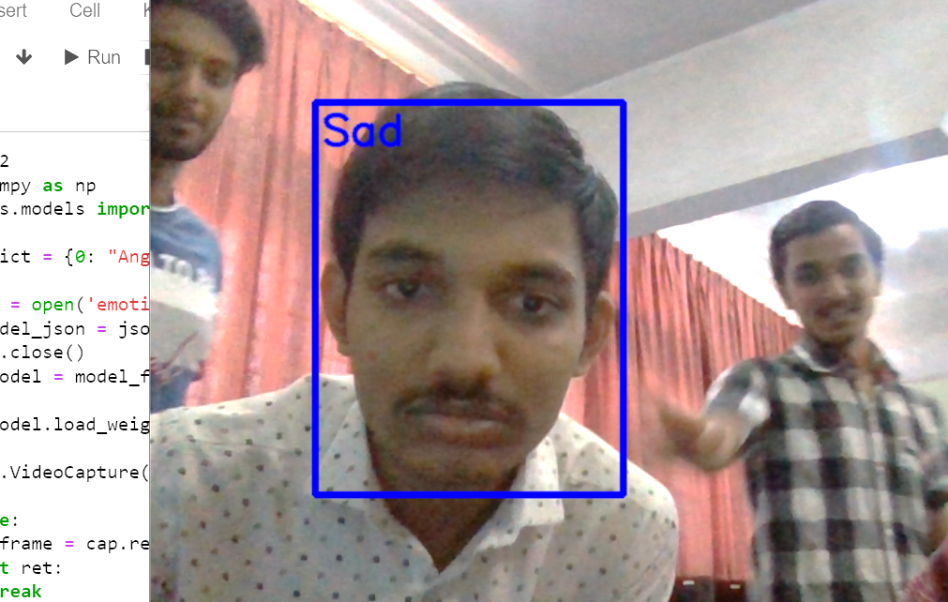
Snapshots

Slide 17
Conclusion
In this we used two models and OpenCV to get the required output. Benefit of using two models is multiple faces will be detected in frame.
The face detection and emotion recognition are very challenging problems. They require a heavy effort for enhancing the performance measure of face detection and emotion recognition.
In this project we used CNN(Convolutional Neural Network) to train the model. This method have some advantages and some disadvantages.

Slide 18
Thank You!

